Slide 1
Aws s3 storage
ow

Slide 2
Simple storage service
S3 is aws object storage that can store data, file images
It is managed service from aws
Highly reliable, Scalable
Data is accessible from anywhere and anytime over the internet
Store data in form of objects.
Globally unique name, Will be created in Specific Region
Each object will stored in key value format, name of the object and value is content of object

Slide 3
..
Bucket names must be unique across all AWS accounts in all the AWS Regions within a partition. A partition is a grouping of Regions. AWS currently has three partitions: aws (Standard Regions), aws-cn (China Regions), and aws-us-gov (AWS GovCloud (US)).
A bucket name cannot be used by another AWS account in the same partition until the bucket is deleted. After you delete a bucket, be aware that another AWS account in the same partition can use the same bucket name.

Slide 4
..
Single object upto 5TB you can store
It is recommended to object larger in the size, must be split in parts and store
Usecases:
S3 can be used to host static websit
It can be used as datalake where you can store structured and unstructured data
S3 can be used storing backup and long-term archives

Slide 5
lab

Slide 6
Static website hosting
S3 bucket can host static website
Need to enable the option
Create policy for the same
Provide the policy doc, who can access

Slide 7
Lab to host static website

Slide 8
S3 versioning
It allows you keep multiple versions of an object in the same bucket, provides you protection of any kind of accidental deletion as well overwrites
When versioning is enabled, s3 stores every version of an object. It allow you to recover older version if needed, making it ideal for data safety and backup
Versioning is a means of keeping multiple variants of an object in the same bucket. You can use versioning to preserve, retrieve, and restore every version of every object stored in your Amazon S3 bucket. With versioning, you can easily recover from both unintended user actions and application failures.

Slide 9
lab

Slide 10
S3 replication
It allows you to automatically copy objects from one s3 bucket to another.
In same region [SRR- Same region replication]
Different region [CRR- cross region replication
It will be used for compliance, redundancy purpose
Lab purpose you must have one more bucket created.
It can be in the same region or across regions

Slide 11
lab

Slide 12
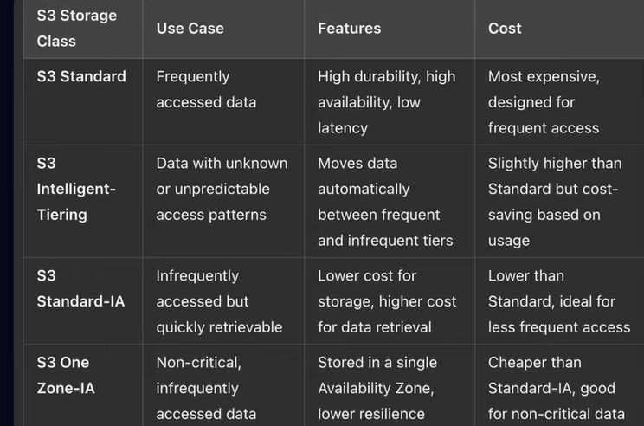
S3 storage class
S3 paid service

Slide 13
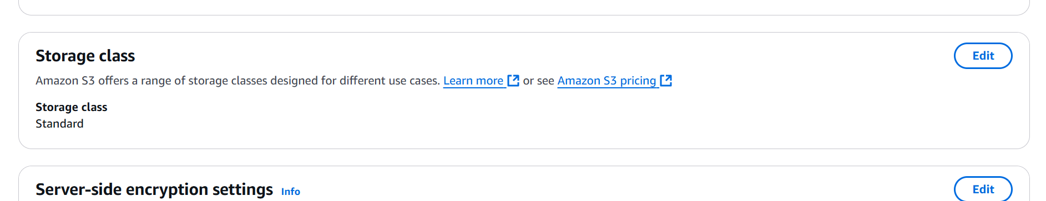
..

Slide 14
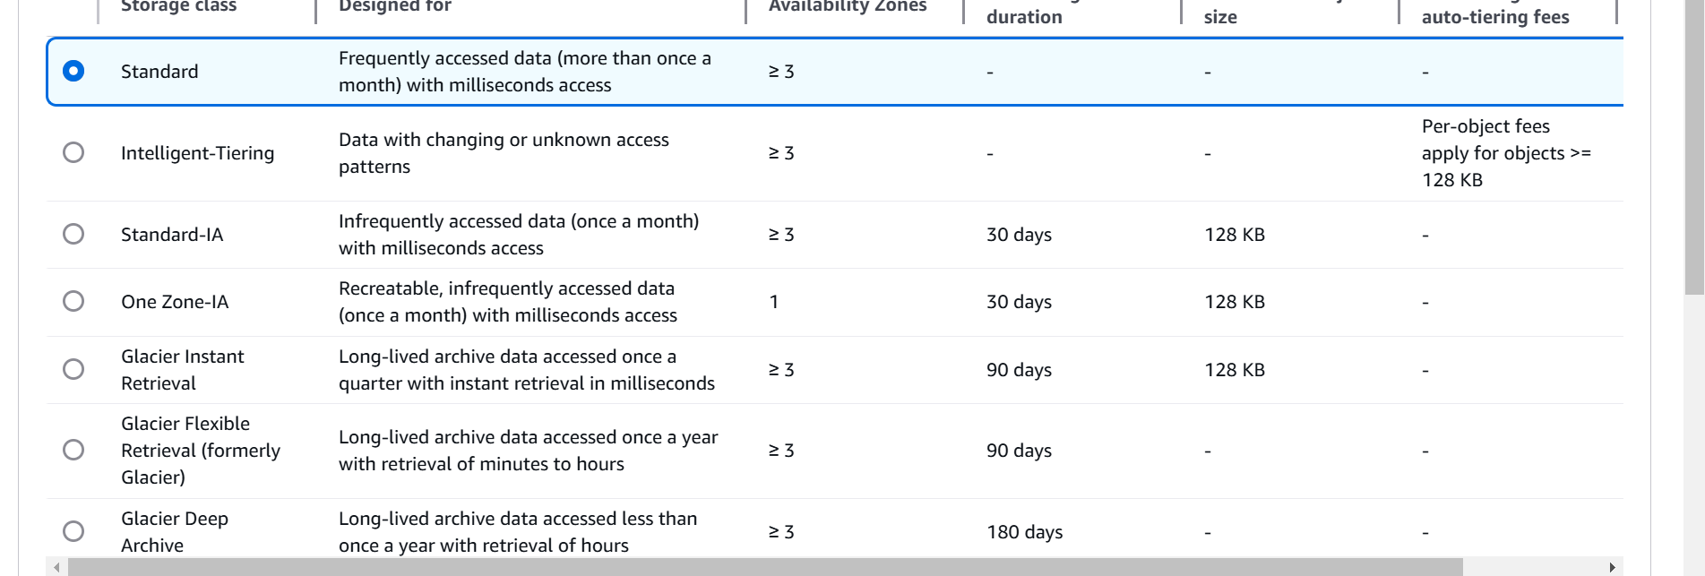
..

Slide 15
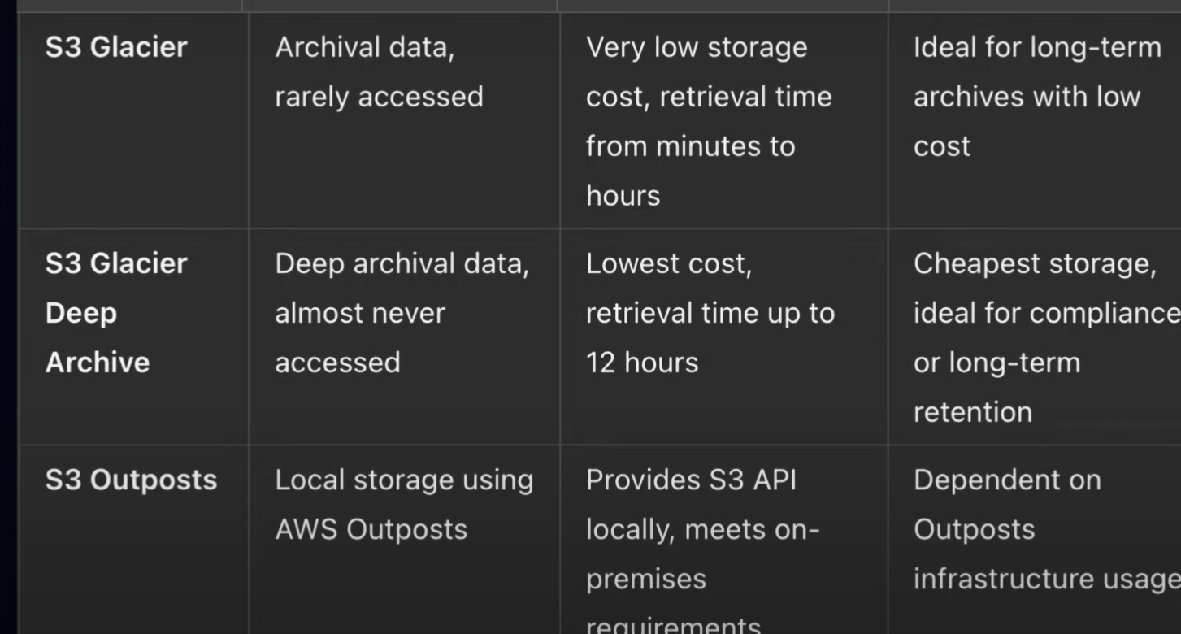
..

Slide 16
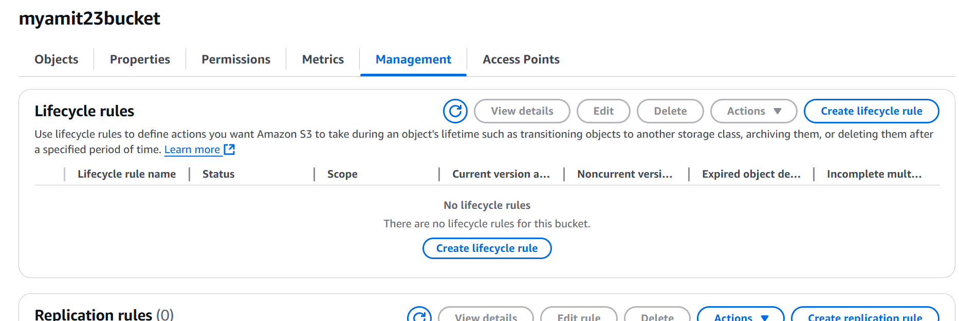
S3 bucket lifecycle
Control the object between storage classes, based on utilization we can keep data and delete the data
We can change the storage class, or remove the data

Slide 17
lab

Slide 18
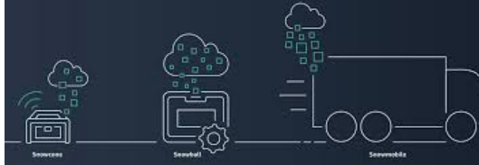
S3 snow family
S3 snow family is a group of physical devices by aws to move large amount of data to the cloud when using internet
When huge amount of data has to migrated
AWS Snowcone
AWS Snowball
AWS Snowmobile

Slide 19
..
Snowcone: a small, portable device for few terrabytes
Snowball: A large device for moving petabytes of data
Snowmobile: A massive truck-sized container, entire datacenter movement from company to aws

Slide 20
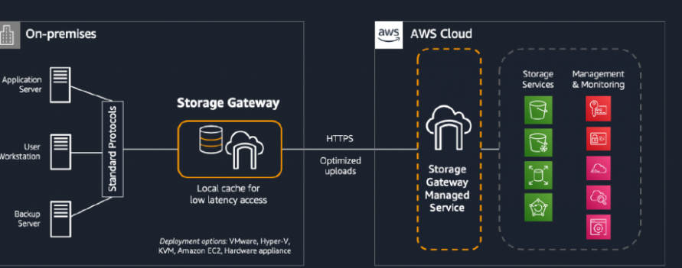
S3 storage gateway
It is hybrid cloud service that connects on-premises environment to cloud storage.
It will act as bridge where computing is in your DC, and aws is providing storage
This will act as bridge

